Slide 1
Dementia Provision
What issues are coming up?
Services available
Services needed

Slide 3
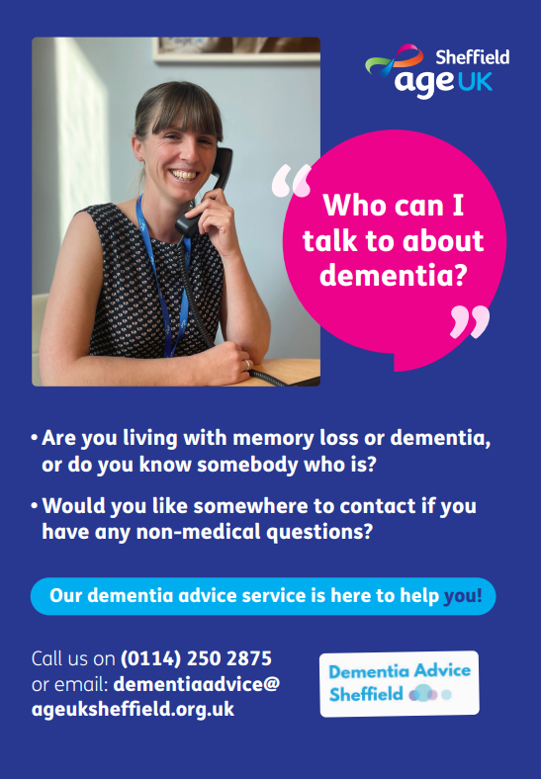
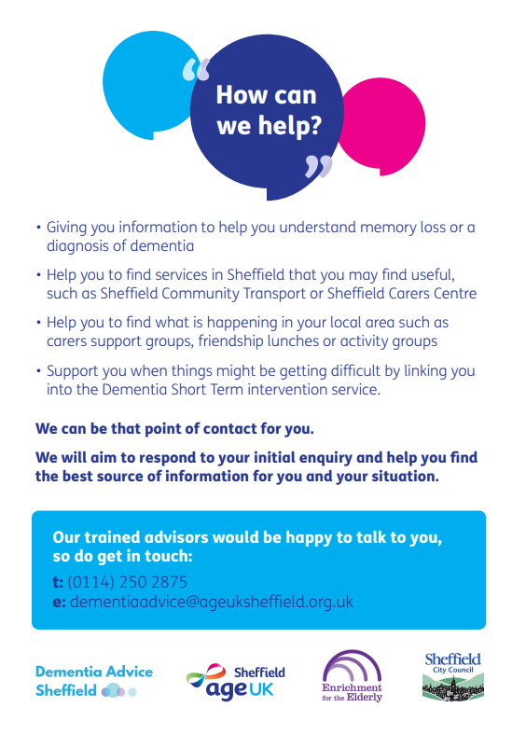

Slide 4
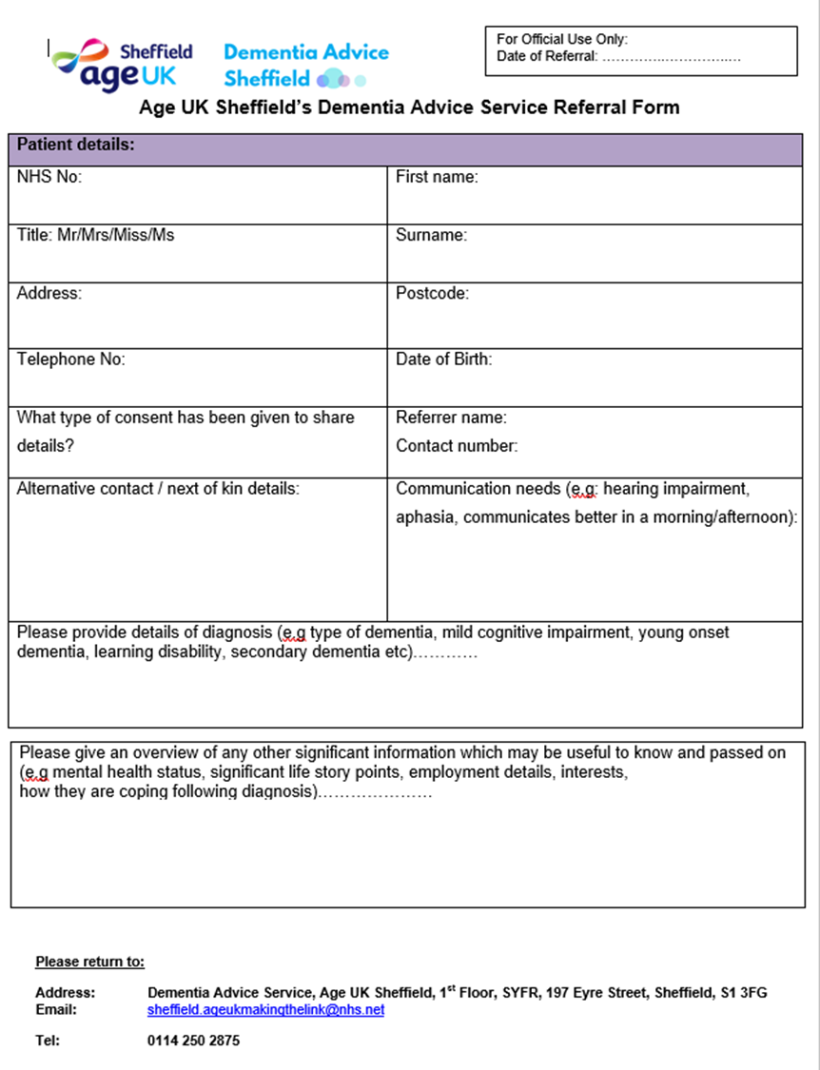

Slide 5
Dementia info & a friendly listening ear
6 monthly wellbeing calls
Memory cafes
Dementia carers groups
Singing groups & choirs
Allotment, gardening & farming sessions
Exercise sessions
Social dining
Sporting memories
Coffee mornings
Dementia Wellbeing Centres*

Slide 6
DAS Workshops
Dementia Stars
Needs led training
Dementia Network Meetings

Slide 7
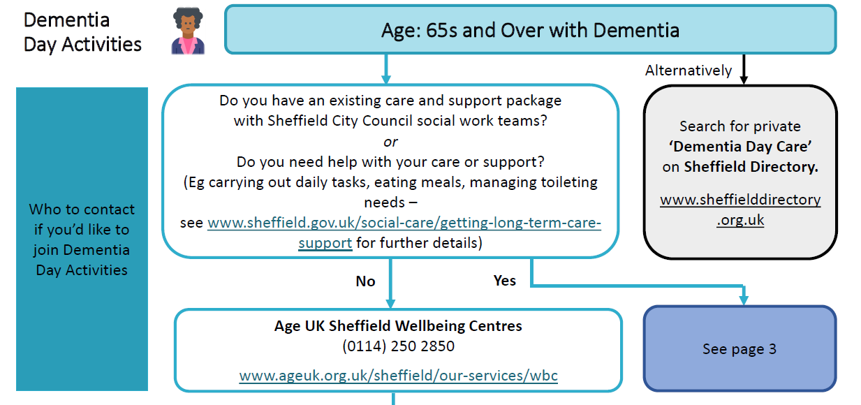
Dementia Day Activities
Age UK Sheffield – no care package
Norfolk Park
Hillsborough Pavilion
Botanical Gardens
Clifford House
CF care package
Sheffcare
Care2Care
Darnall Dementia Group

Slide 8
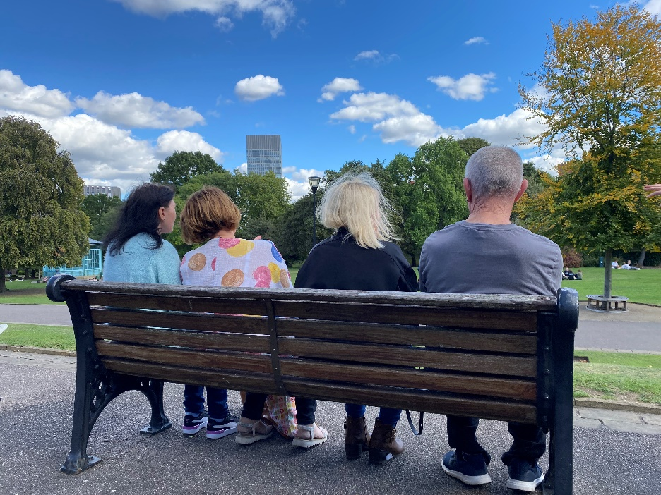
Young Onset Provision
Dementia Day Activities
North Sheffield – Care2Care
South Sheffield – Botanical Gardens Age UK Sheffield
Young Onset Hub
Everyone welcome, fortnightly peer support group
Contact DAS for more information

Slide 9
Sheffield Dementia Action Alliance
Making Sheffield a Dementia-Friendly City
Get in touch: SDAA@ageuksheffield.org.uk

Slide 10
Get in touch
0114 250 2875
dementiaadvice@ageuksheffield.org.uk

