Slide 1
“Volunteering is an act of heroism on a grand scale. And it matters profoundly. It does more than help people beat the odds; it changes the odds.”
Bill Clinton

Slide 2
Volunteering
Volunteering is not about:
delivering services cheaply
replacing or substituting staff.
Volunteering is about:
improving the experience of people using services,
improving the culture and quality of services and;
strengthening the links between services and communities.

Slide 3
Why people volunteer?
Sense of connection to others in the community
Improve their physical & mental health and wellbeing
Make new friends
Show your commitment and giving something back
Improving confidence
Gain new skills and valuable work experience
Improve how things work for the better

Slide 4
Reason volunteers leave
Not feeling inspired
Not making friends or having fun
Feeling uneasy or unqualified
Not feeling recognised
Being unaware of their impact
Not being given the opportunity to do something new within the organisation

Slide 6
Levels of Volunteering – by Age

Slide 7
Advertising with the Volunteer Centre
- Free service accessed via our website: www.sheffieldvolunteercentre.org.uk
- Roles need to meet our minimum quality standards:
Welcomed whatever background they come from
Safe
Properly insured
Adequately trained
Supported and supervised
Not used to replace paid staff
Reimbursed for out of pocket expenses (travel expenses as a minimum) if you
have paid staff.

Slide 8
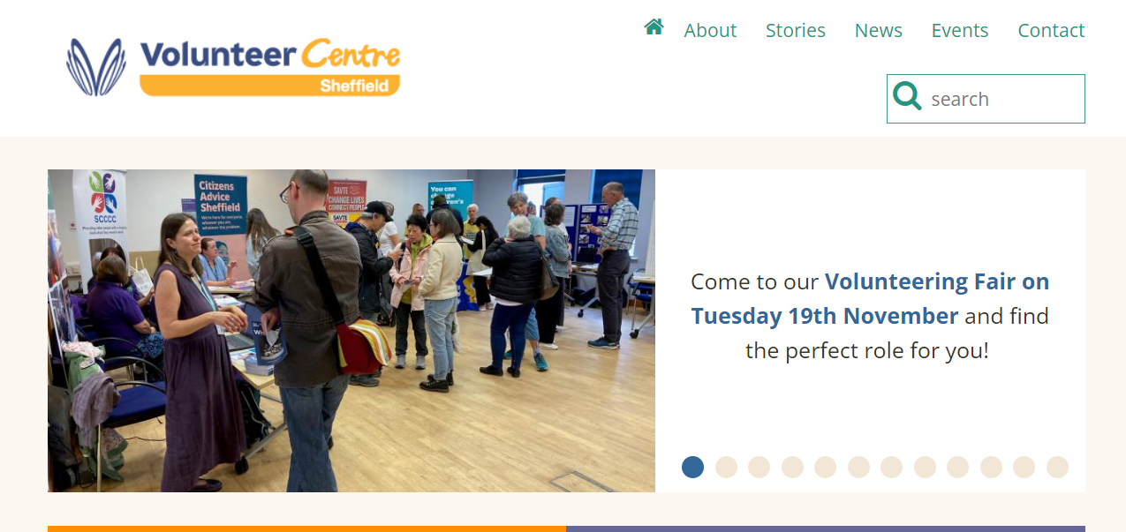
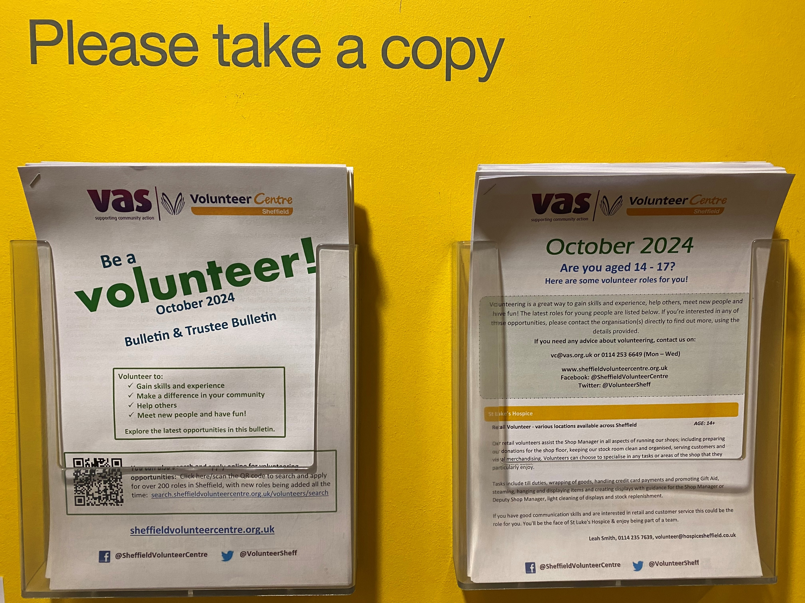
How we advertise your roles
Website
Bulletins
Tuesday drop-in at The Circle
Outreach events
Social media
Questions: vc@vas.org.uk /
(0114) 253 6649 (Mon – Weds)

Slide 9
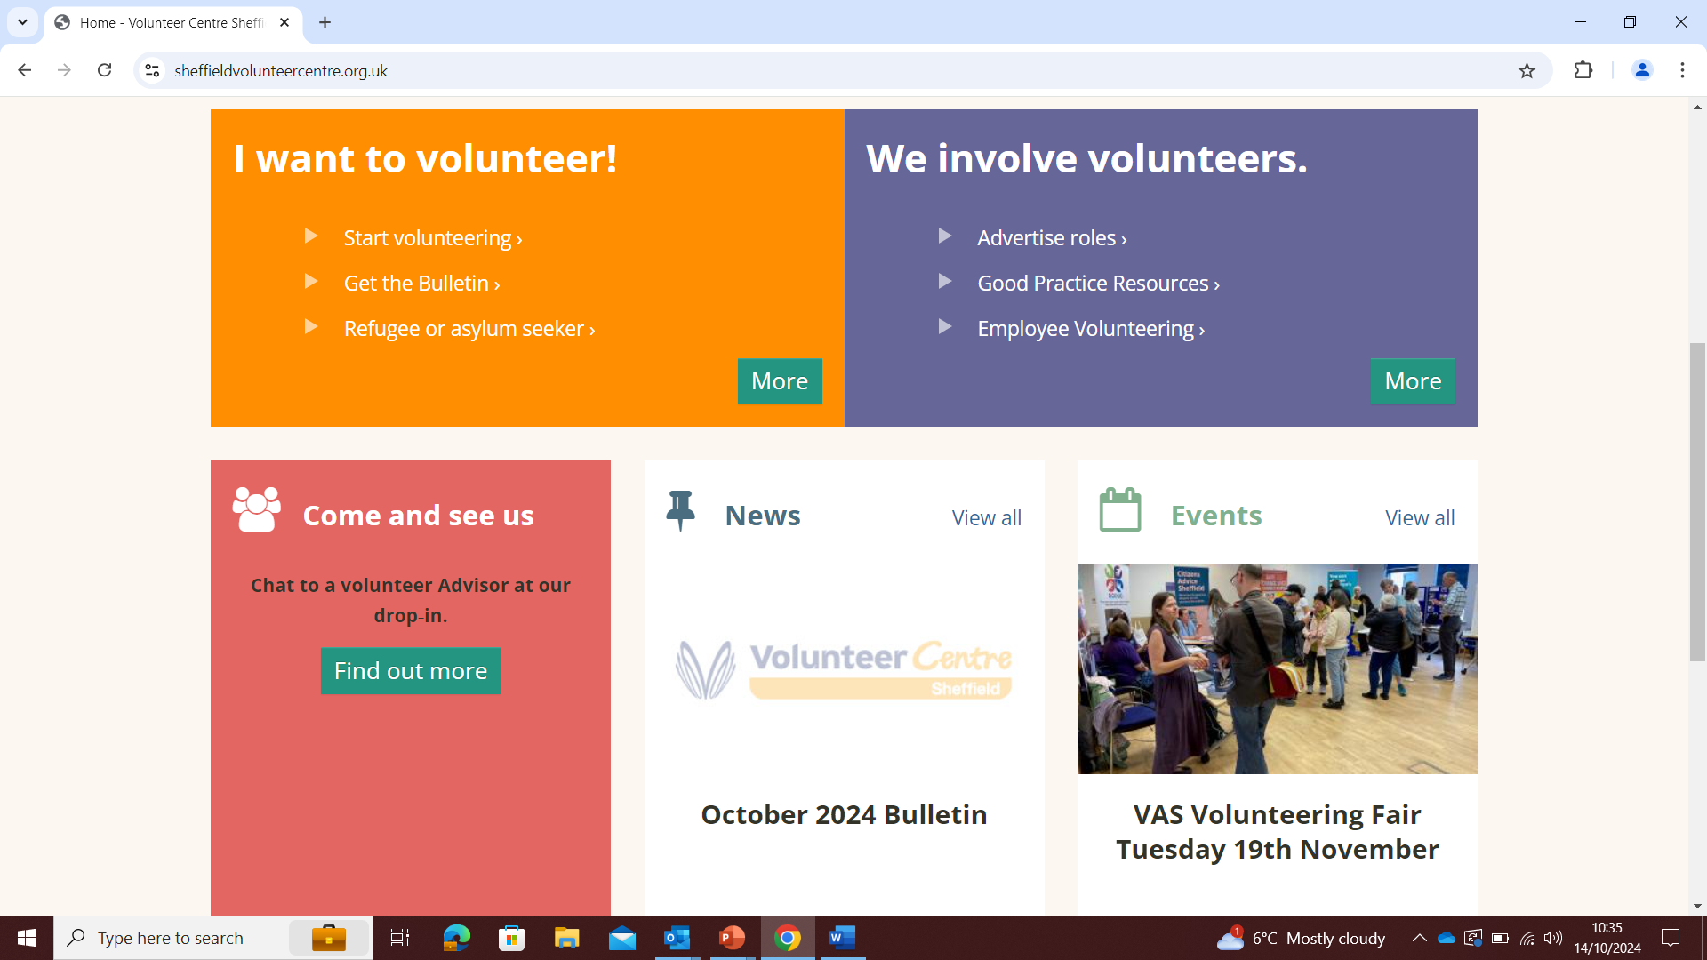

Slide 10
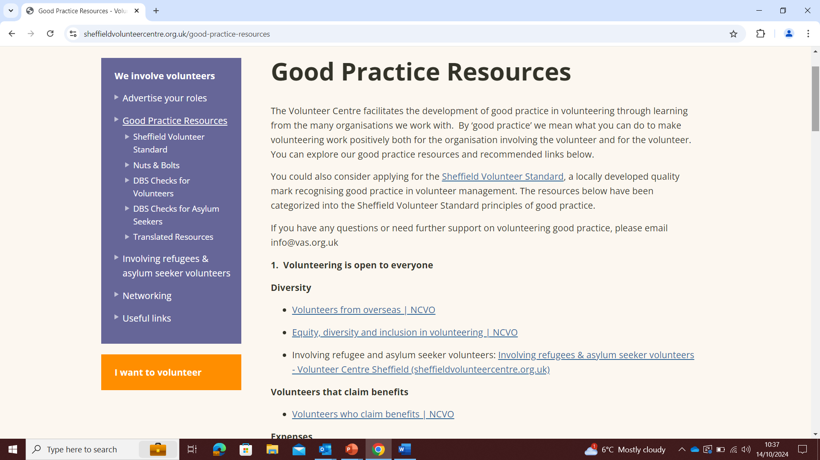

Slide 11
Support to involve volunteers:
Support to develop attractive and inclusive volunteer roles
Recruitment – advertising and promoting roles
Developing policies and processes
Good practice advice and guidance relating to volunteer management.
Help with problem solving
Networking-join our mailing list and meet others at the regular Volunteer Coordinators’ Forum
Contact: info@vas.org.uk
Or ring Reception on 0114 2536600

Slide 12
www.vas.org.uk
Our vision is for people to work together to make a vital and growing contribution to quality of life in all Sheffield’s communities.
Our mission is to support the development of voluntary and community action in a professional way, so it is sustainable & brings about positive social change.

