Slide 1
Older People’s
Nutrition and Hydration
– Training Presentation
Preventing avoidable harm
Maintaining independence
Improving health and quality of life
@GMNandH
Notes:
INTRODUCE the training and how long it will be, with some interactive elements for them to get involved with and contribute ideas to.
READ the bullet points.

Slide 2
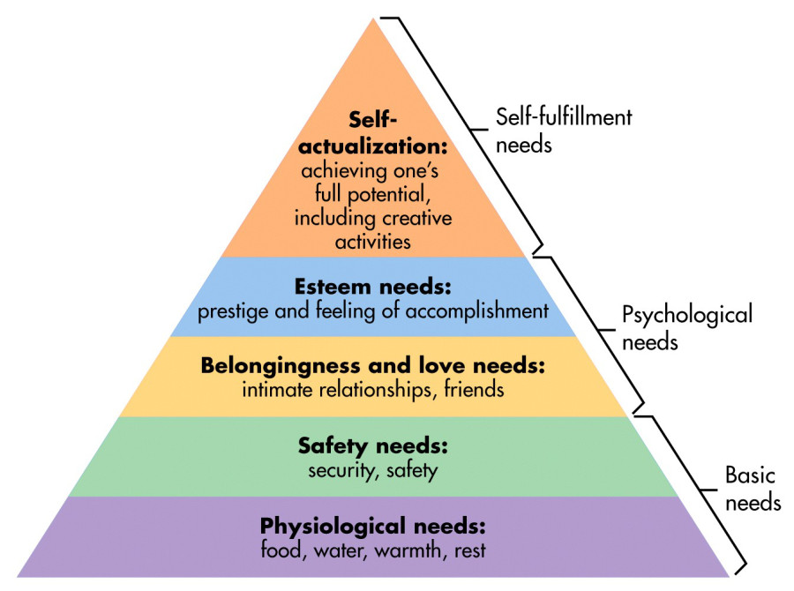
Eating and drinking are basic needs, fundamental to an older person’s overall health and well-being
We shouldn’t assume that older people want to or remember to eat & drink. For many older people, isolation and low mood can affect their inclination to eat & drink, they will need encouragement, support and prompts to aid them
It’s everyone’s responsibility: Be the person that helps older people to eat and drink well
Malnutrition is one of the 4 top priorities identified by the GM Ageing Hub / GM Food Cell
Image from simplypsychology.org
Notes:
Maslow’s triangle highlights the most basic of needs being food, water, warmth & rest. Without these no-one can thrive but it is more important the older you get.
Eating & drinking is fundamental for an older person’s OVERALL health and well-being.
READ the bullet points.
HIGHLIGHT eating & drinking as one of the TOP 4 PRIORITIES by GM Ageing / GM Food Cell.

Slide 3
Part 1: The Nutrition and Hydration training aims to reduce risk factors through early intervention by:
Helping carers and community workers to open up a conversation with an individual about appetite and unplanned weight loss
Using an innovative non-intrusive tool, the ‘Paperweight Armband©’, developed by Salford Together
• Using a ‘Food First’ approach with those identified at risk
The Salford model shows that making a few healthy food choices can improve the length of life and quality of life.
Notes:
READ the slide

Slide 4
Malnutrition - What is it ?
Over-nutrition (obesity)
Malnutrition (meaning poor or bad nutrition) and
Under-nutrition
For many older people it is characterised by low body weight or weight loss,
meaning simply that some older people are not eating well enough to maintain
their health and wellbeing.
NICE defines a person as malnourished if they have:
A BMI (Body Mass Index) of less than 18.5
Unintentional weight loss greater than 10%, within the past 3-6 months
A BMI of less than 20 and unintentional weight loss greater than 5% within the past 3-6 months
Notes:
DEFINE malnutrition and consider the two different extremes – obesity / malnutrition.
This training concentrates on UNDERNUTRITION in relation to OVER 65s.
READ the slide (animations can be removed if they are distracting).
The PAPERWEIGHT ARMBAND has been developed to indicate a BMI of 20 if it fits around the mid-part of the upper non-dominant arm and 18.5 if it is lose / slips up and down this part of the arm.

Slide 5
Malnutrition in older people
Risk and prevalence increase with age
1 million people (1 in 10) over the age of 65
People over 75 years are at highest risk of malnutrition
93% of these are living at home
5% living in care homes
2% in hospitals
‘in recent years, it has largely remained under the
radar - older people are starving in their homes’
Malnutrition Task Force www.malnutritiontaskforce.org.uk. Malnutrition in Later life: Prevention and Early Intervention. Best Practice Principles & Implementation Guide. A Local Community Approach. Feeding Britain
Notes:
READ the slide (animations can be removed if they are distracting).
HIGHLIGHT that most people (93%) live at home and may not come into regular contact with different services / agencies / groups, so any malnutrition may be hidden or missed.
The people living in care homes or staying in hospital will have more regular contact with nurses, doctors, auxillary staff, care workers and managers. Even with lots of contact with professionals, 5% & 2% will still become malnourished.

Slide 6
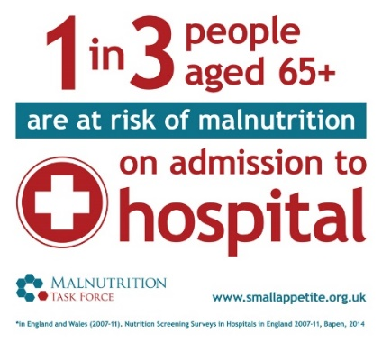
Why focus on malnutrition?
47%
of all people who fall are malnourished
Images from Malnutritiontaskforce.org.uk
Notes:
It’s a hidden problem
It’s all around us - A third of recent arrivals to hospitals and care homes are already malnourished (or at risk)
The consequences - For every 10 days a person over the age of 80 is in hospital they lose 10% of muscle mass, they have slower healing wounds, a longer recovery time and generally become sick more often
It is preventable – Losing weight is not a natural part of growing old
It’s expensive – Malnutrition costs the health and social care system around £19-20bn per year – relate this to longer stays in hospital, higher costs of treatment and being admitted more often. A&E presentation for older people for a fall has huge costs attached
It affects vulnerable people most – The older you are, the more likely you will be at risk

Slide 7
Which costs more to the NHS?
Malnutrition
Obesity
£12 billion per year
£6 billion per year
Notes:
USE the animation to show the title first, asking the question WHICH COSTS MORE TO THE NHS? – in the context of malnutrition and obesity, then the next animation to show the scales
DISCUSS the issue about obesity being everywhere, with many different campaigns about reducing the obesity figures BUT malnutrition is largely ignored, even though the costs are DOUBLE!
This may be due to obesity being more VISIBLE and malnutrition being INVISIBLE.

Slide 8
Add Local Area Stats – Malnutrition and Dehydration
• Average population of approximately 226,493 – ADD YEAR
• Over 65 years population is 40,026 – ADD YEAR
• If 10% - 14 % are malnourished = 4,002 – 5,603
If 20% are dehydrated = 8,005
• The population aged 65+ is expected to grow to around ADD LOCAL NUMBERS people in 2037 (Local area.gov.uk)
Notes:
OPTIONAL SLIDE
ADD local stats. This will need to be adapted to reflect the population within the area the training is being delivered – local data may be on Gov.uk website or in a local JSNA through the council or public health department.

Slide 9
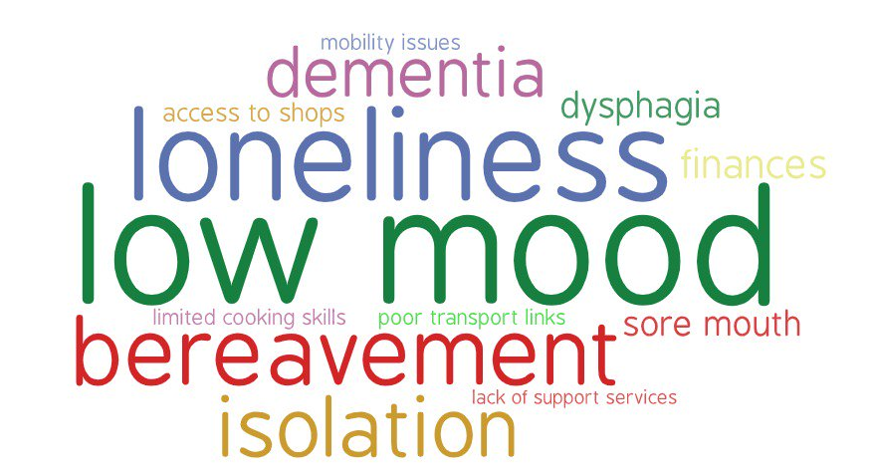
Notes:
READ the slide giving examples where possible – my partner used to do all the cooking but they are in hospital / my partner always drove me to the shops and I don’t know which bus to catch on my own / I can’t be bothered cooking just for me, so I just have a slice of toast / I find it difficult to stand for long periods of time, so I can’t prepare a meal………. Offer some solutions, such as food deliveries, ready meals, batch cooking, lunch clubs etc.
OUTLINE that it only takes 2-3 days to become malnourished – so if they are seen on a Thursday by workers or family and then not seen again until the following Monday, they could become malnourished.
HIGHLIGHT that in many cases, it is PREVENTABLE AND TREATABLE and NOT a natural consequence of getting older!

Slide 10
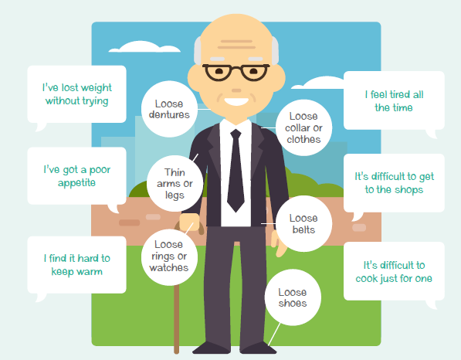
Signs to look out for
Verbal
Visual
Notes:
DIFFERENT ways to check – verbal or visual or BOTH.
READ the writing on the picture and EMPHASISE that it can be simple things that indicate there is a concern.

Slide 11
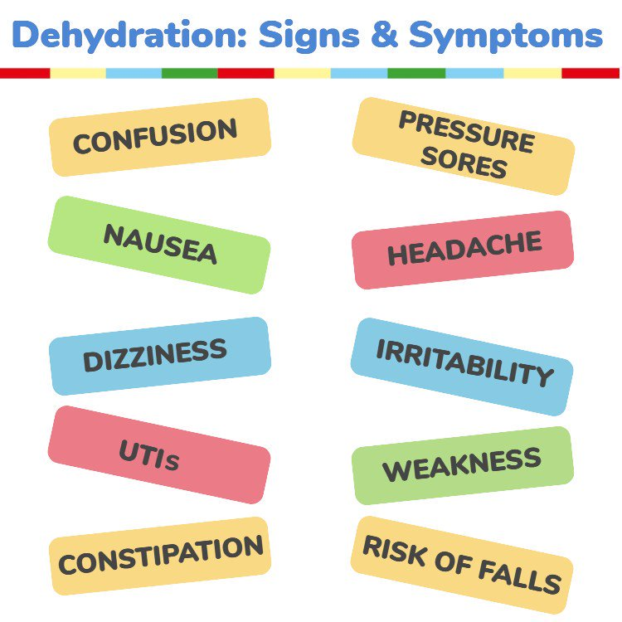
Dehydration - What is it?
Dehydration is fluid loss
Thirst is a useful indicator of daily fluid needs but most people are already mildly dehydrated by the time they feel thirsty.
Age-related changes include a reduced sensation of thirst, which may be more pronounced in those with Alzheimer’s disease or who have had a stroke.
Dry mouth, lips and tongue and sunken eyes, Fatigue, Headaches, Dizziness, Memory issues, Low or no urine output / dark concentrated urine.
Source: British Nutrition Foundation
Notes:
READ the slide
HIGHLIGHT that a reduced sense of thirst due to age or a condition, may mean that prompts to drink are needed.
DRAW attention to the many different signs & symptoms of dehydration – these will have some baring if the case study ‘Emily’s story’ is used at slide 15.

Slide 12
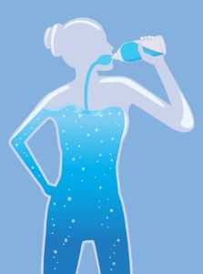
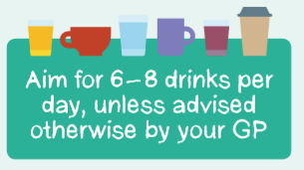
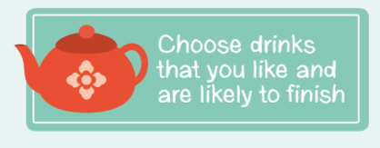
Some key stats - dehydration
20%
28%
of older people are dehydrated
have impending dehydration
This leads to admissions to hospital for:
Confusion
UTIs
Falls
Constipation
Increased risk of infection / sepsis
Low mood and energy so loss of independence and mobility
Notes:
READ the slide
HIGHLIGHT the number of drinks needed in a day and how dehydration can lead to hospital admissions – this can be referred back to the costs mentioned in SLIDES 6 & 7.

Slide 13
Benefits of Good Nutrition and Hydration
Greater Independence
Improved
Health and Wellbeing Energy levels Mobility Concentration
U
P
D
O
W
N
Reduced
Urinary Tract Infections (UTIs)
Use of Anti-biotics
Falls
Notes:
READ the slide EMPHASISE greater independence, which most older people want to keep for as long as they can.
NOTE – the reductions are all things that have a cost to health services as well as the older people themselves.
Animations can be removed if they are distracting

Slide 14
What do you do if someone you are working with…
Has lost weight without meaning to?
Often has no food or out of date food in the cupboards?
Looks like their clothes or jewellery are
loose?
Looks very thin?
Has a poor appetite?
Often has urine infections?
Has low energy?
Seems confused?
Is dizzy or has had a fall?
Often does not finish drinks?
Can you think of anyone you are working with that is showing any of these signs?
* Wait! Before you refer to the GP, can you use a different approach?
Notes:
READ the slide – use the animation to remind people to consider a FOOD FIRST approach before referring to a GP (last statement in red).
Discussion points:
WHY might a person display these symptoms?
What are some of the UNDERLYING CAUSES?
How LIKELY are you to notice any of these symptoms?
What would you DO if you noticed any of these symptoms?

Slide 15
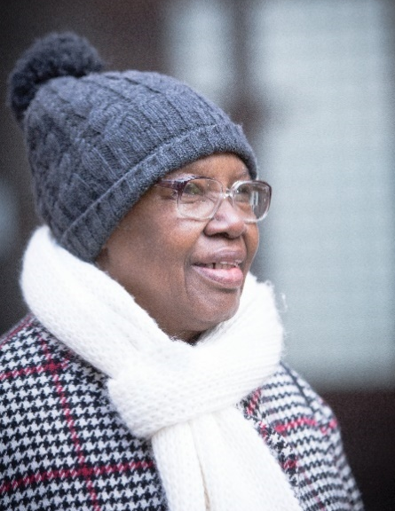
Optional Real life Stories
Explore:
Emily’s case study
Hidden Hunger
Grandad’s Story
https://vimeo.com/403103060
Notes:
OPTIONAL SLIDE
Depending on the group being trained, use one of the 3 optional stories or miss this slide out of the presentation.
Emily’s story – see notes
Hidden Hunger:
In pairs or groups spend 2 minutes reading he story
Read out to the rest of the group & discuss
what are the barriers to the people in those scenarios?
what could you suggest / do to support those individuals?
what services would be available locally to signpost to?
Grandad’s story – watch the short 4 minute clip and discuss how things can go wrong and how to find solutions for these.

Slide 16
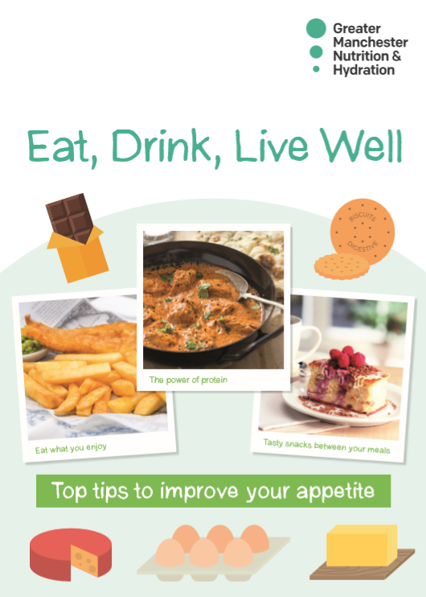
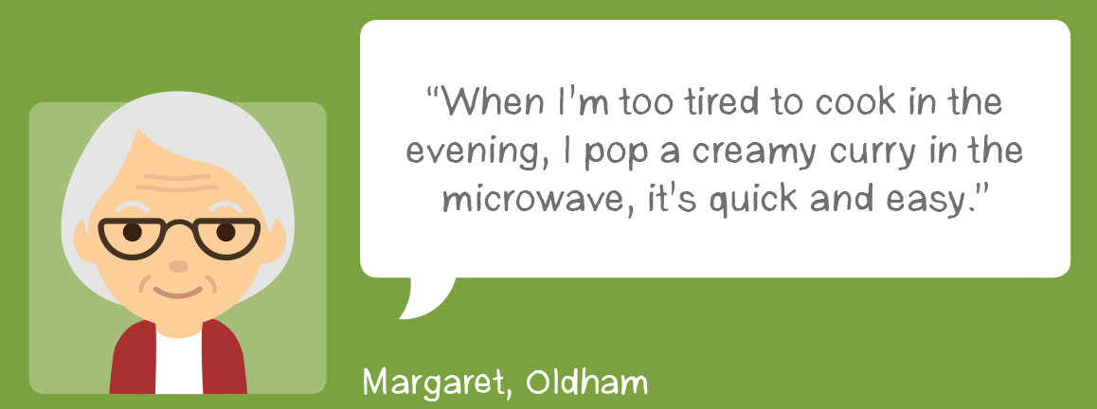
Research by University of Manchester has found that simple conversations can make a big difference for older people at risk of malnutrition
1. Simple advice
What have you had for tea tonight?
What kind of things have you been eating?
How are you getting your food supplies?
2. Gentle encouragement
3. Social support
Further information:
https://www.ageuk.org.uk/bp-assets/globalassets/salford/images/nutrition-and-hydration/nutrition-and-hydration-programme-final-report-4th-june-2020.pdf
Notes:
INFORMATION:
An independent evaluation by the University of Manchester has shown that 80.6% of those at risk of malnutrition have had a positive outcome (compared to an initial CBA assumption of 30%)
Frailty levels of the participants are a significant factor in how they respond to the intervention (correlation between level of frailty and likelihood of positive impact)
This strengthens the evidence base around the importance of early intervention
A reduction in malnutrition can stop and even reverse a person’s frailty
Full report link is at the bottom of the slide.
READ the slide & EMPHASISE the 3 points.

Slide 17
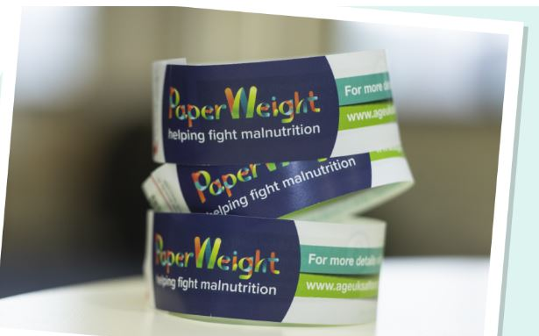
The PaperWeight Armband
81%
Positive outcomes from University of Manchester evaluation
Notes:
SHOW the PAPERWEIGHT ARMBAND but demonstrate how to use it in slide 22

Slide 18
Nutrition and Hydration Programme
Part 2: Be a Nutrition and Hydration Champion
3 Cs - to Good Nutrition and Hydration
1. Conversations
2. Check
3. Care
Notes:
READ the slide

Slide 19
1. Conversations - Nutrition Start by having a chat about appetite, eating, drinking and weight loss
Shall I make a drink?... The milk has gone off…
‘How are things with you,
are you well?’
You don’t seem your smiley self today….. Is everything ok?
How is your appetite these days?
Have you seen these Paperweight Armbands before? Do you want to give it a go?
Have you tried those ready meals yet?
You haven’t been going to………….is everything ok?
Notes:
READ the slide and discuss.

Slide 20
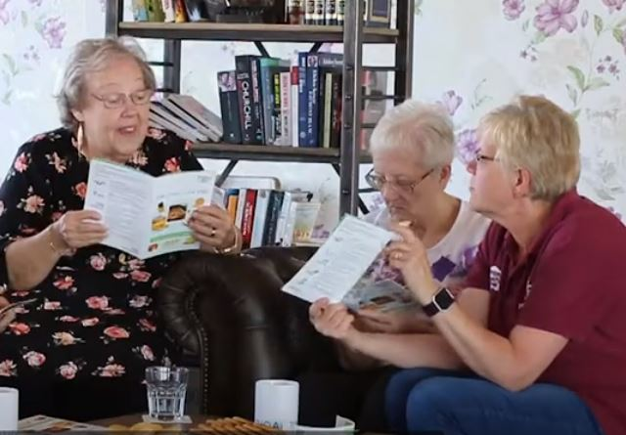
Simple conversations
Encouraging people to eat and drink well through simple conversations
They can be part of a chat rather than directed questions
Key questions to see if people may need to change their diet:
Have you lost weight without meaning to?
Have you had a poor appetite, low energy or low mood?
Do your clothes, shoes, jewellery or dentures look or feel loose?
Do you think you might be underweight?
Highlight key messages from the Eat, Drink, Live well booklet if they answer yes to any of the questions above
Post materials and reinforce messages through future support
Notes:
READ the slide
HIGHLIGHT the questions BUT ensure that they use them in a way that will benefit the older person, so a chat covering weight, appetite and any changes they may have noticed or be experiencing is probably the better way to approach this.
SHOW the Eat, Drink, Live Well booklet as the main resource, if you are concerned about an older person’s eating & drinking.

Slide 21
When should I refer to a health professional?
You can use the ‘RED FLAG’ questions below as a guide
Refer to the GP if the person answer yes to any of
the following:
Have you noticed sudden weight loss (10% of body weight in 3 months)?
Do you have difficulty swallowing food or drinks?
Do you get a pain in your tummy when you eat?
Have you had a recent persistent change in your bowel movements to looser stools and/or increased frequency?
Anyone at risk of malnutrition should also be encouraged to see their Dentist, particularly if they have a sore mouth
Notes:
IMPORTANT
The RED FLAG questions are used to check if the older person’s weight loss, swallowing issues, stomach pain or change in their bowels, have an underlying cause, which will REQUIRE a referral to a GP or Dentist.
If your mouth or teeth are sore, this can prevent an older person from eating, drinking, taking medication and breathing properly.

Slide 22
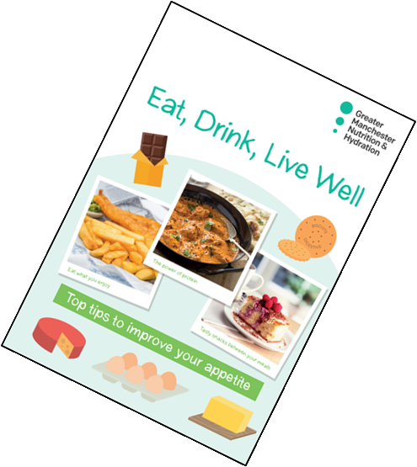
2. Check - Ask if you can try the Paperweight Armband© (or use MUST) - Put the armband around the upper non-dominant arm - If it fits and / or it is loose then offer the, ‘Eat, Drink, Live Well’ booklet - Do you need to signpost to other services?
Notes:
DEMONSTRATE the PWAB on self or each other.
READ the slide.
DISCUSS – do they think the older people they are in contact with, will be willing to use the PWAB, if not use the VERBAL or VISUAL cues mentioned in SLIDE 10.

Slide 23
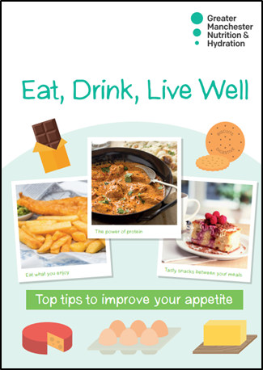
Highlight the 3 main ideas in the, ‘Eat, Drink,Live Well’ booklet to help improve appetite and gain weight
3. Care
Eat 6 small meals or snacks – little and often
Food Fortification – add calories to small portions for extra energy and nutrients
Cupboard and freezer ideas – keep ready meals available
Notes:
SHOW the E,D,LW Booklet and highlight a couple of sections that may be pertinent to the group.
EXPLAIN about the additional resources: see SLIDE 33.

Slide 24
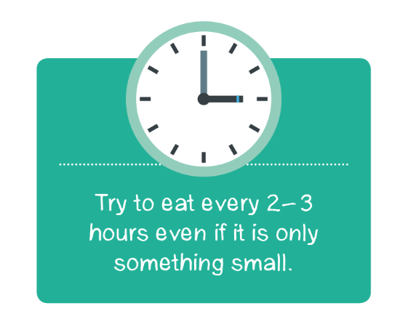
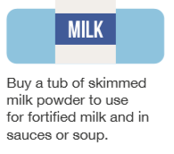
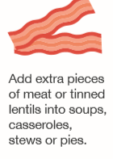
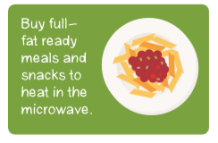
Main tips from the Eat, Drink, Live well booklet
Eat little and often
Use milk powder to fortify milk, sauces and soup
Eat with others
Some people are having a shared lunch over a video call or watching a favourite programme while eating
Add to your food to increase energy without increasing portion size
Have more protein
Make meal preparation easier
This is called fortifying food
Notes:
READ the slide:
Eat little and often – some people may be over faced by a big meal so they should try having smaller portion sizes, if they do this, they will need to have snacks between their meals. 6 small meals or snacks are as good as 3 big meals. Page 7 of the booklet has some ideas.
Add cream, butter, cheese and milk powder to meals and snacks. This helps to increase energy without increasing portion size. Page 8 has some ideas for this.
Adding skimmed milk powder to food and drinks can be a very easy way to get extra calories and nutrients. There is a recipe for fortified milk on page 11. This doesn’t make it any thicker and should not change the taste.
Protein can help keep us strong, eggs, beans, lentils, meat and fish can all help.
Eating with others may be difficult at this time, people are being creative about how they can do this – talking to friends and family about what they eat, having video calls while eating their lunch, watching their favourite programme.
Ready meals and pre-prepared sauces can help to make meal preparation easier. There are lots of meal delivery services, some are listed on Page 12 of the booklet. Also, tinned and frozen fruit and veg is just as good as fresh.

Slide 25
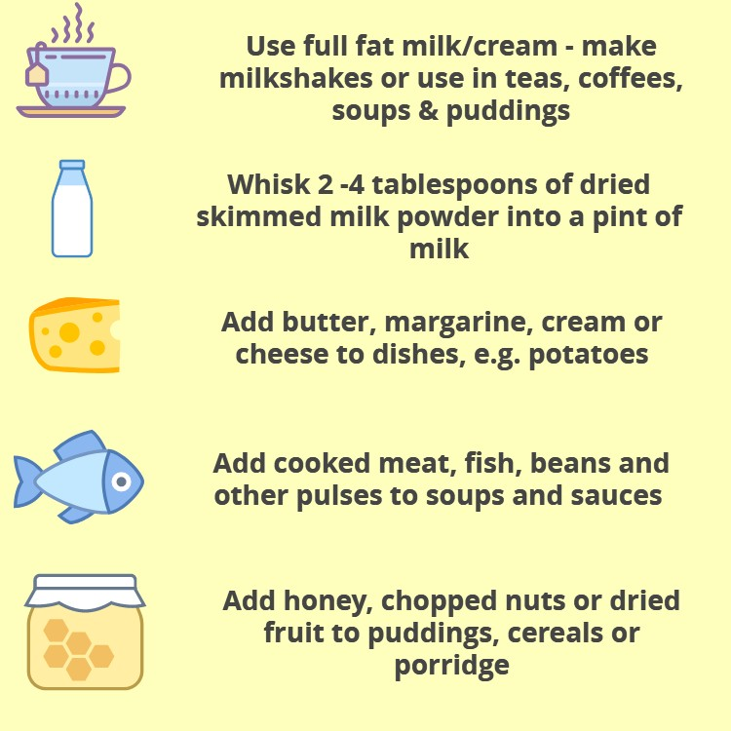
What is a fortified diet?
A fortified diet describes meals, snacks and drinks which have had additional high calorie and protein foods added to them e.g. cream, milk and butter
This helps to prevent weight loss, improve energy intake and maximises the nutritional content of a dish so that every mouthful counts
Image from Eatwellagewell.org.uk
Notes:
EXPLAIN what a FORTIFIED DIET is and HOW they can boost the calorific value of a meal, without increasing the size, especially important if the older person doesn’t have much of an appetite.
Animations can be removed if they are distracting.

Slide 26
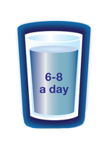
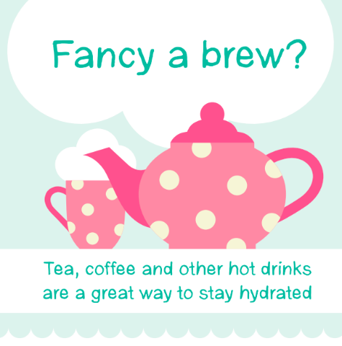
1. Conversations - Hydration
What drinks do you like?
What have you had to drink today?
Are you having 6-8 drinks a day?
Many of us don’t drink enough,
particularly as we get older
It is safe and healthy to encourage
everyone to drink more and stay well hydrated
Notes:
DISCUSS each bullet point and why an older person might not be drinking enough, with some solutions.

Slide 27
2. Check - food, fluid intake and oral hygiene
To stay healthy adults need to drink 2 to 2.5 litres of water per day. This equates to 6 to 8 cups. Cross the cup out once a cup of fluid has been drunk. Although water is best as it contains no sugar or caffeine, also tea, coffee, milk, squash, pop and juice will count, though be mindful of high sugar drinks as they can rot your teeth. Beer and wine do not count!
Mouthcare | Mouthcare | Mouthcare
Breakfast | Lunch | Evening meal | Snacks
I ate | I ate | I ate | I ate
The colour of urine is a good way to establish if a person is dehydrated if they are under 65, if they are over 65 it cannot be used REMEMBER – PRESUME DEHYDRATION
Confusion, constipation, feeling dizzy, falls, peeing more often, headaches = DEHYDRATION
Notes:
READ the slide and DISCUSS how they can monitor an older person’s food / fluid intake and oral hygiene, if applicable.
This simple visual chart can be displayed on a fridge or cupboard door and filled in by the older person or carer or family member.
This chart is only one example – use any example from your local organisations or other ways, if a chart isn’t a feasible method.

Slide 28
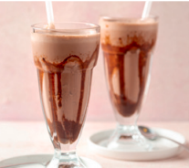
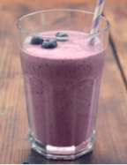
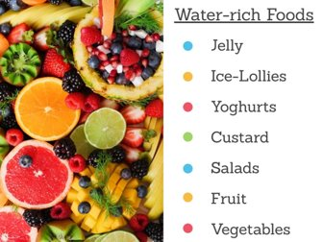
Ask which drinks they enjoy Talk about tasty, refreshing drinks or have a mocktail party! Have they tried…….. a smoothie? Identify water-rich foods Make a brew! Suggest an alarm reminder or use TV programmes ending / starting as a prompt
3. Care
Image from Eatwellagewell.org.uk
Notes:
READ the slide and EXPLORE different methods of encouraging older people to drink more, in a person-centred approach, looking at what works for the individual.

Slide 29
Show how you have made a difference!
Record it and report it.
Then we can share your achievements!
Monitor prevalence or hotspots in your local area
Notes:
READ the slide and stress that ‘if it isn’t written down, it didn’t happen’
If you have nutrition and hydration recorded, then you can report it wider to show how your organisation is making a difference.
It may also help to sustain funding or justifying future funding.
It demonstrates that an holistic approach is being used and eating & drinking will not remain invisible.

Slide 30
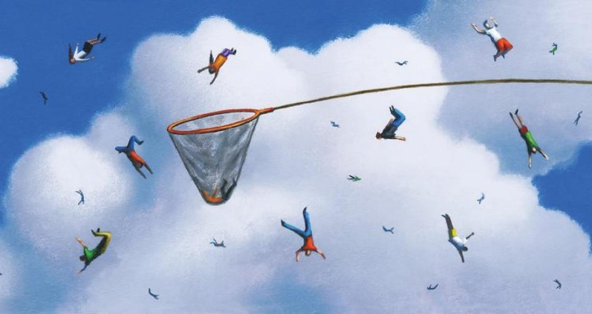
Spotting the signs – don’t let anyone slip through the net
Keep an eye out for the signs and symptoms we have discussed
Sometimes we are busy and can miss the signs, so make a habit of asking the ‘key questions’ to everyone and observe any changes
Have you brushed your teeth?
What drinks have you had today?
If the person looks thin, use the Paperweight Armband.
Remember, if someone is wearing a jumper you may not notice, at first, how thin they are
Image from tes.com
Notes:
READ the slide and ensure they feel comfortable with the information this training has given them.
ENSURE the key questions form part of every contact they have with an older person, where relevant.
Answer any questions.

Slide 31
Final messages
You don’t need to be an expert, often it is about encouraging people to make small changes that will make a big difference.
Many people may not have realised they were underweight or that they could do something about this.
If you are worried, you can encourage them to see their GP or contact the local community Dietitian. Check the red flag questions if you are concerned.
Notes:
READ the slide.

Slide 32
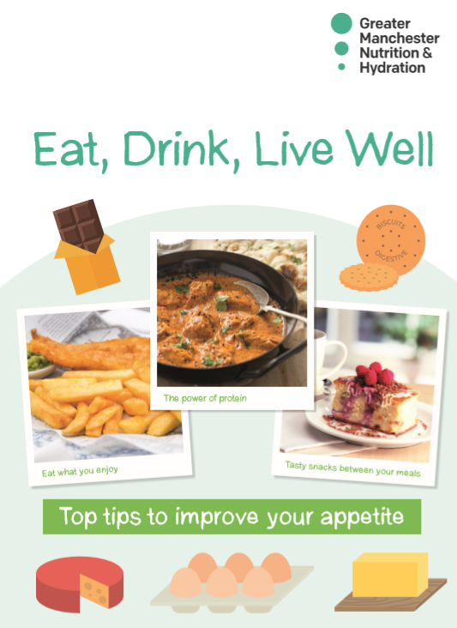
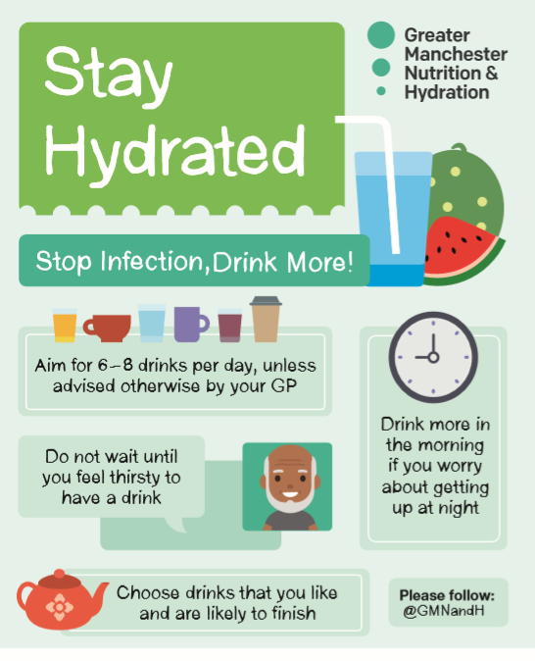
What can I do?
For everyone
Raise awareness with friends, family, neighbours and
colleagues
Ask older people the key questions and share simple advice if needed
Promote e-learning tool
Disseminate nutrition & hydration resources
5 minute briefing at team meetings
For strategic leaders and service managers
Incorporate key nutrition and hydration questions and gentle prompting and guidance to existing interactions with older people, e.g. in welfare calls, through care and support
Put older people’s nutrition and hydration on the agenda and consider it in strategic planning and recovery planning, use commissioning to embed good practice
Notes:
READ the slide
Go through each bullet point
DISCUSS what they can do and any good practice examples they may have.
SHARE messages with senior managers and encourage them to include nutrition and hydration as a priority, in any strategic planning for your local area.

Slide 33
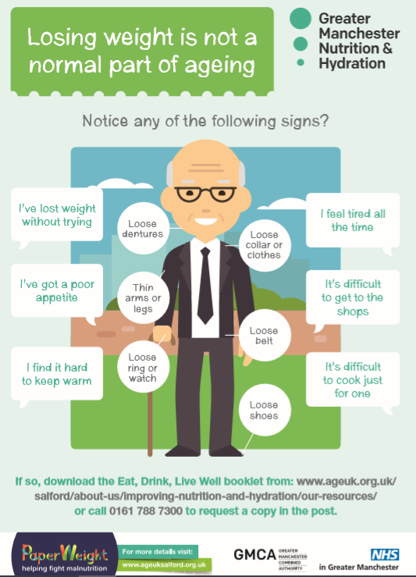
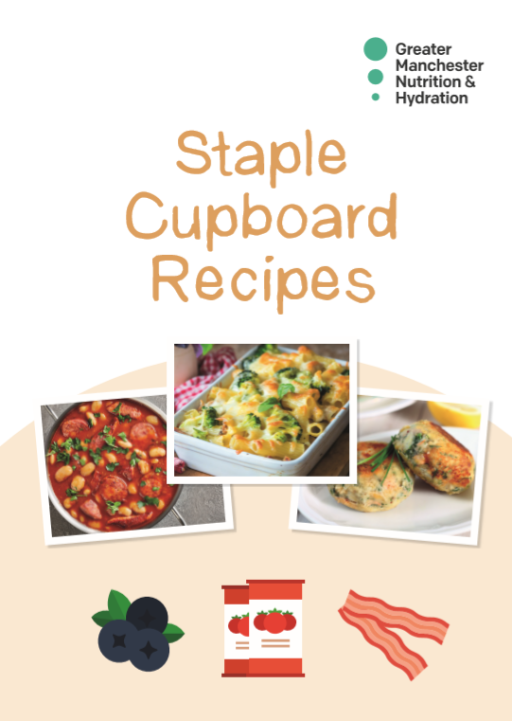
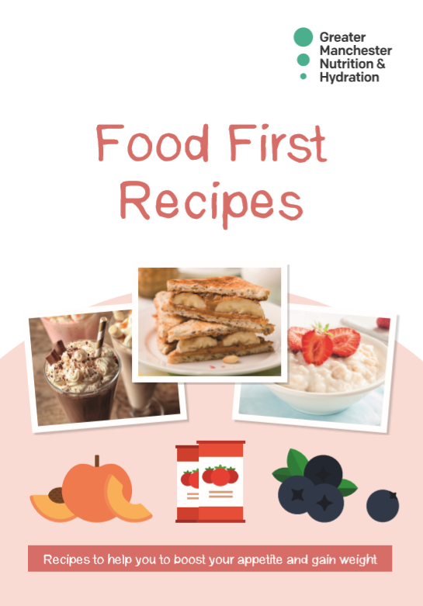
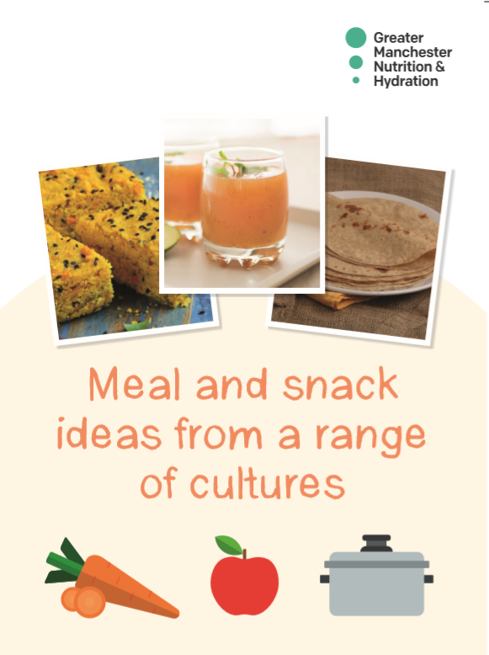
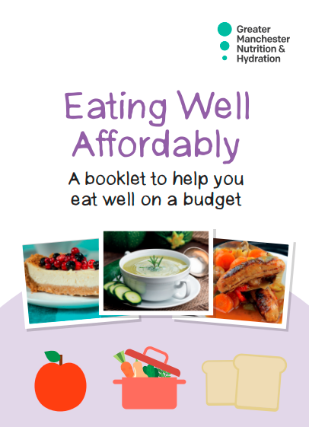
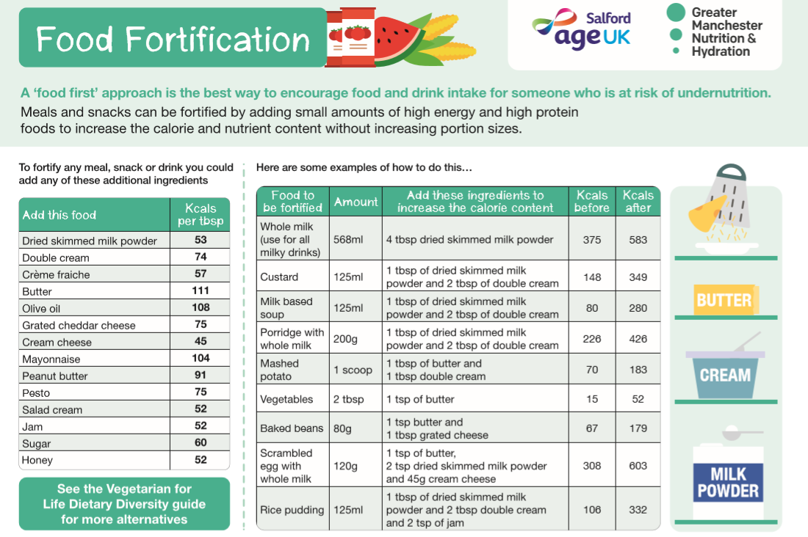
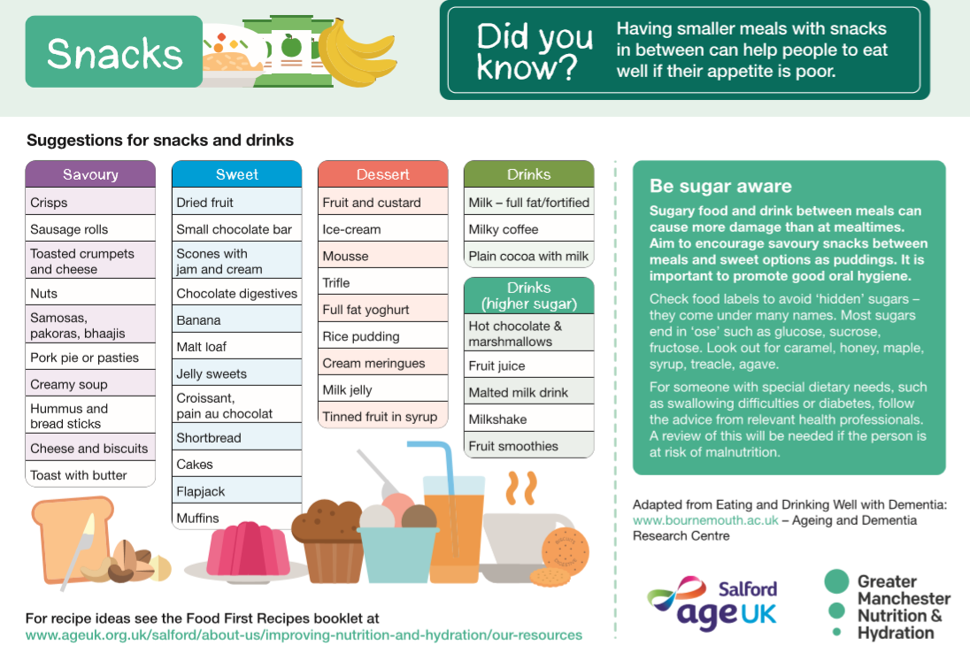
Available Resources
E-learning tool www.paperweightarmband.org.uk
PaperWeight Armbands
Eat, Drink, Live well booklet – tips to boost appetite and fortify food
Food first recipes – recipe ideas for high energy meals and snacks
A5 Hydration Leaflet & Malnutrition Signs & Symptoms for raising awareness
Staple cupboard recipes – simple recipes using mainly tinned and frozen food
Eating Well Affordably – simple affordable recipes
Meal and snack ideas from a range of cultures – different ideas and recipes to try from different cultures
Care Home kitchen posters – Food fortification/snacks
Notes:
READ the slide – the resource descriptions in RED are only to be given to older people, if there is a concern (undernourished / poor appetite / loosing weight), they are NOT to be given to older people of an average / above average weight. The other resources are for all older people over 65.
All RESOURCES are available at:
https://www.ageuk.org.uk/salford/about-us/improving-nutrition-and-hydration/our-resources/

Slide 34
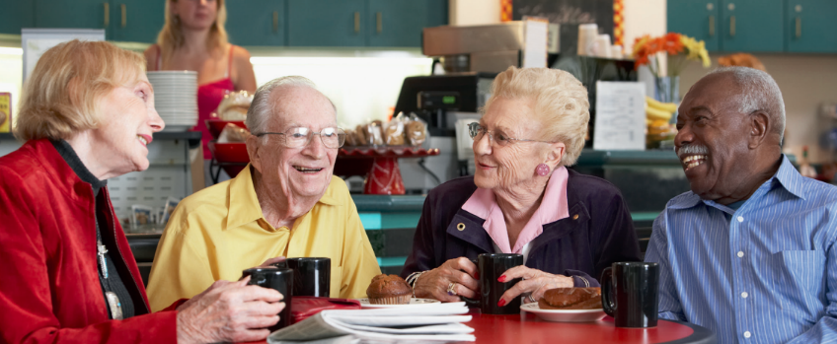
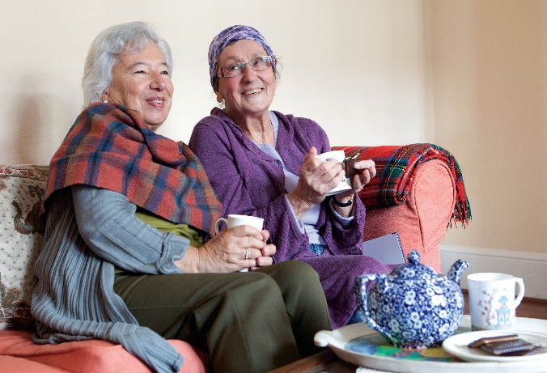
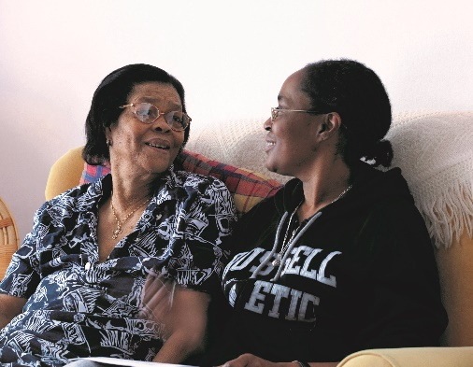
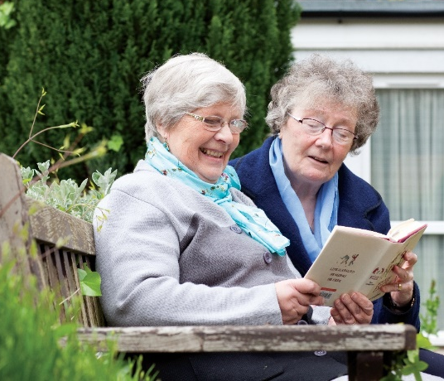
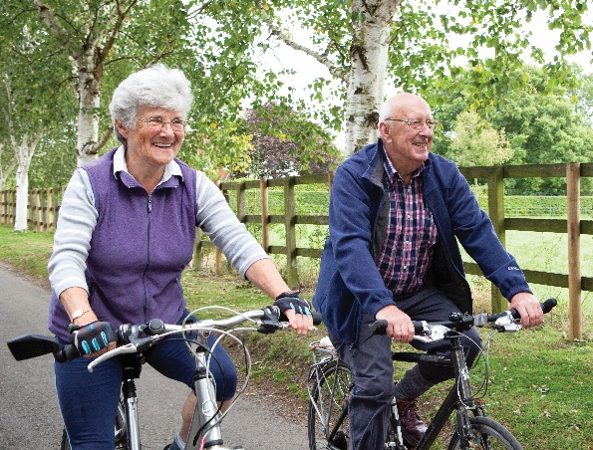
Ultimate goal
Older people stay happy, healthy and independent for longer
Notes:
PASS on a contact number / details, so workers can ask any follow up questions, order any resources or ask for other teams to receive this training.

Slide 35
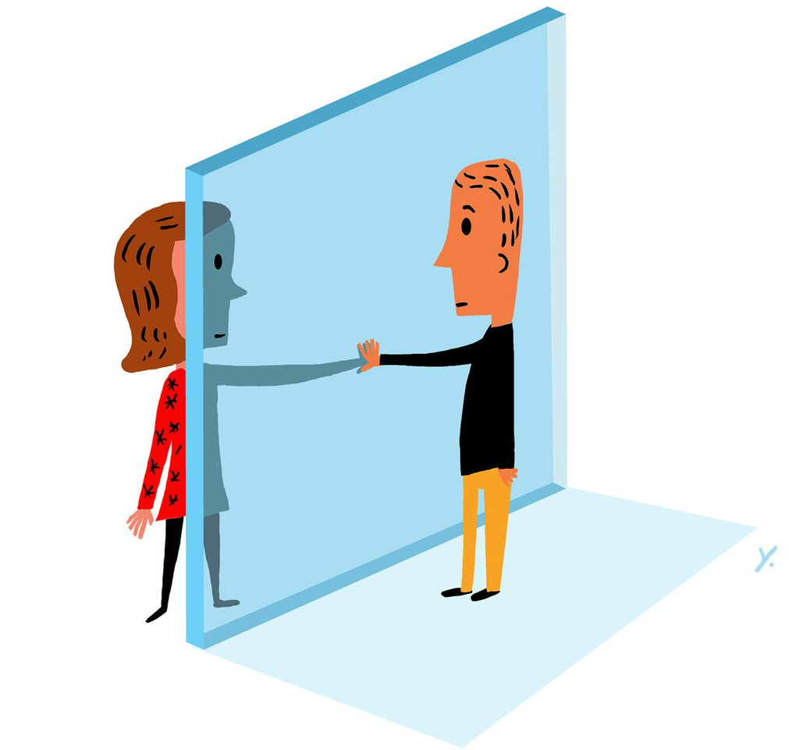
Increased risk due to COVID-19
Many risk factors are increased due to current social distancing measures
Increased risk for those who are vulnerable and shielding; have limited food access and from social isolation
Also, people who have been in hospital with COVID-19, are experiencing high levels of weight loss
https://www.ageuk.org.uk/salford/our-services/information-and-advice/staying-well-during-the-coronavirus-pandemicoronav
Notes:
Unintentional weight loss, especially if rapid weight loss usually reflects loss of muscle mass, which may be particularly relevant for people recovering after a period of intensive care
Malnutrition can increase a person’s risk of infection as well as slow down their recovery
Weight loss, especially if rapid weight loss usually reflects loss of muscle mass, which may be particularly relevant for people recovering after a period of intensive care
In turn this slows their recovery and may consequently result in readmission to hospital and further complications

