Slide 1
Greater Manchester Nutrition and Hydration Programme
Malnutrition Awareness Week 2023

Slide 2
Why?
Malnutrition affects 1 in 10 older adults in the UK and this figure is growing due to the Covid-19 pandemic.
This year, UK Malnutrition Awareness Week takes place between 10th – 16th October
This annual campaign has been set up by BAPEN and the Malnutrition Task Force to
help raise the profile of malnutrition and encourage everyone to be able to recognise
the signs & symptoms and highlight the importance of screening those at risk.
Read more on the Malnutrition Task Force website
Notes:
DEFINE malnutrition and consider the two different extremes – obesity / malnutrition.
This training concentrates on UNDERNUTRITION in relation to OVER 65s.
READ the slide (animations can be removed if they are distracting).
The PAPERWEIGHT ARMBAND has been developed to indicate a BMI of 20 if it fits around the mid-part of the upper non-dominant arm and 18.5 if it is lose / slips up and down this part of the arm.

Slide 3
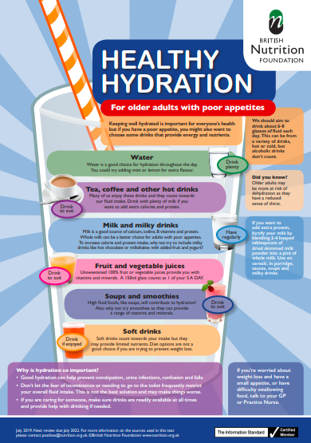
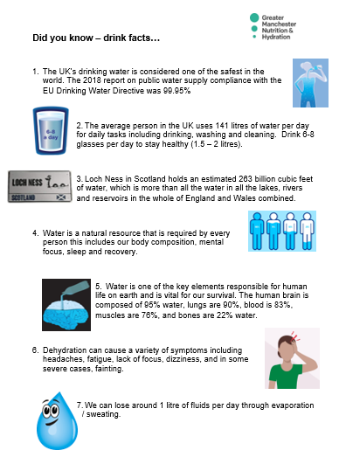
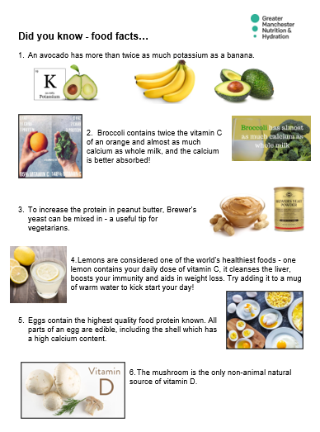
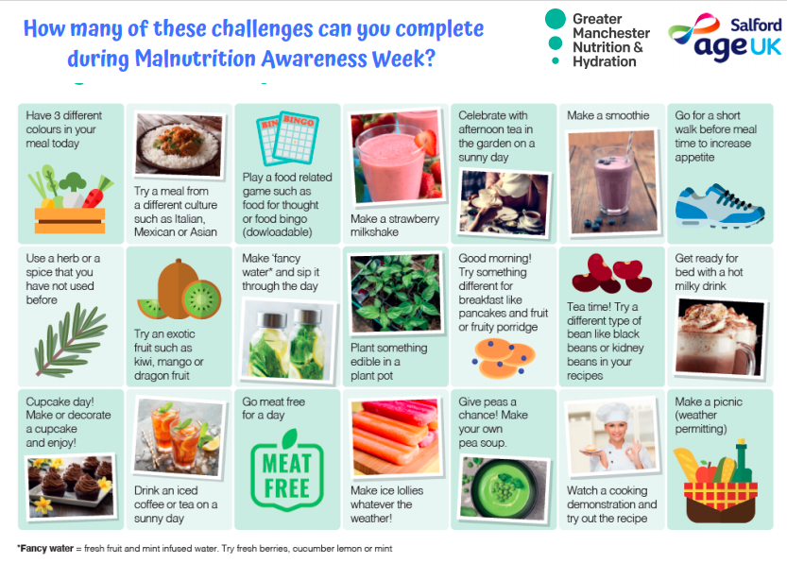
Resources
Download any of our FREE resources on Nutrition and Hydration in older age here:
Add link

Slide 4
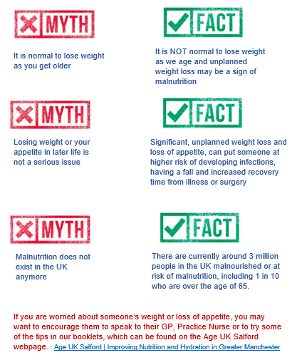
Malnutrition Myths
Notes:
It’s a hidden problem
It’s all around us - A third of recent arrivals to hospitals and care homes are already malnourished (or at risk)
The consequences - For every 10 days a person over the age of 80 is in hospital they lose 10% of muscle mass, they have slower healing wounds, a longer recovery time and generally become sick more often
It is preventable – Losing weight is not a natural part of growing old
It’s expensive – Malnutrition costs the health and social care system around £19-20bn per year – relate this to longer stays in hospital, higher costs of treatment and being admitted more often. A&E presentation for older people for a fall has huge costs attached
It affects vulnerable people most – The older you are, the more likely you will be at risk

Slide 5
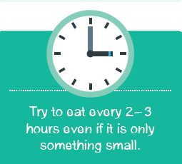
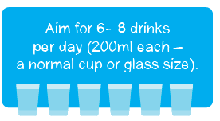
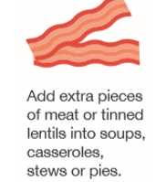
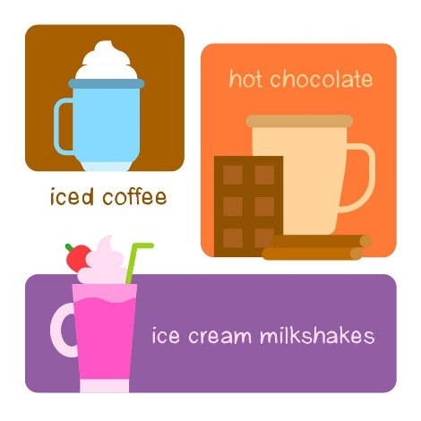
Our Top 10 Tips for Eating Better in Later Life
Notes:
READ the slide
HIGHLIGHT that a reduced sense of thirst due to age or a condition, may mean that prompts to drink are needed.
DRAW attention to the many different signs & symptoms of dehydration – these will have some baring if the case study ‘Emily’s story’ is used at slide 15.

Slide 6
Team meetings
Please save a spot on your agenda for Nutrition and Hydration during this week! If you are planning a meeting in the next couple of weeks, you may wish to include an agenda item, to plan how your team are going to get involved or you can use our short presentation, to raise awareness on the importance of Nutrition and Hydration amongst your staff. You can download the presentation (with the script) on our website.
During Malnutrition Awareness Week, all teams working with older people are asked to review their processes for identifying, if someone is at risk of malnutrition and addressing this with them / their families.
Malnutrition Awareness Week 2023 (ageuk.org.uk)
Notes:
READ the slide
HIGHLIGHT the number of drinks needed in a day and how dehydration can lead to hospital admissions – this can be referred back to the costs mentioned in SLIDES 6 & 7.

Slide 7
Social Media Pack
We have made 5 social media posts which are ready to use, one for each day of the week.
Post on each day with the image, hashtags and tags we have prepared for you. The images are also attached as JPEG files.
You can post these on your Twitter, Facebook page or both.
A simple action like this can really save and improve the lives of many older people living in the UK by busting myths and spreading the right messages about eating and drinking well in later life.
Notes:
READ the slide
HIGHLIGHT that a reduced sense of thirst due to age or a condition, may mean that prompts to drink are needed.
DRAW attention to the many different signs & symptoms of dehydration – these will have some baring if the case study ‘Emily’s story’ is used at slide 15.

Slide 8
Newsletters
On our website, you can download a newsletter insert to add to your own
Newsletter, before or during Malnutrition Awareness Week.
If you are publishing a newsletter for members of the workforce who work with
older people or a newsletter for older people themselves, please include
some of the messages from our suggested newsletter inserts.
Notes:
Unintentional weight loss, especially if rapid weight loss usually reflects loss of muscle mass, which may be particularly relevant for people recovering after a period of intensive care
Malnutrition can increase a person’s risk of infection as well as slow down their recovery
Weight loss, especially if rapid weight loss usually reflects loss of muscle mass, which may be particularly relevant for people recovering after a period of intensive care
In turn this slows their recovery and may consequently result in readmission to hospital and further complications

Slide 9
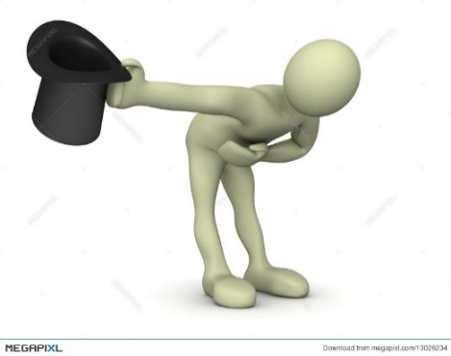
Thank You!
We would like to thank you for helping us spread these important,
yet simple messages.
Together we can make a real difference!

