Slide 1
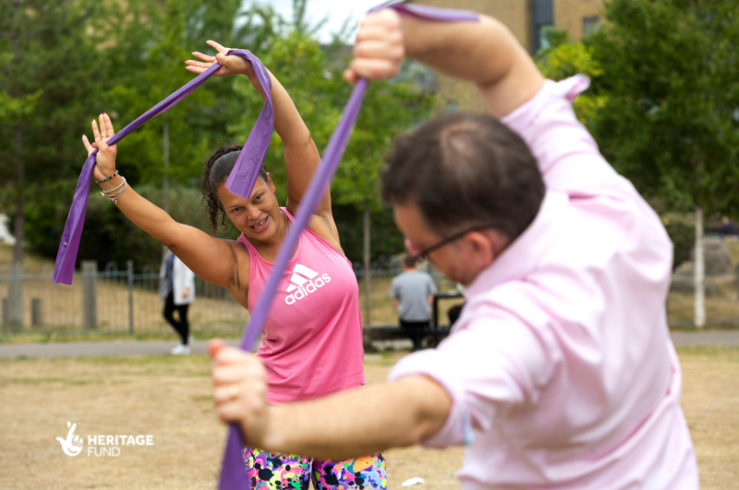
Let’s Talk Keeping Active in Islington
20 March 2025
John Thorne, Physical Activity Manager, Parks, Sports, and Physical Activity Team, Islington Council john.thorne@islington.gov.uk; 020 7527 7096

Slide 2
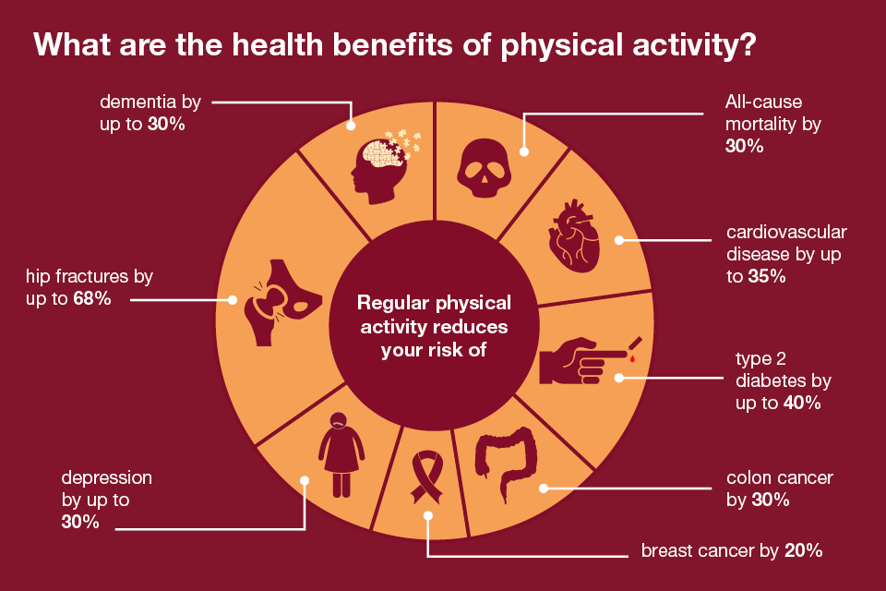
Source: Physicalactivity:applying All Our Health - GOV.UK(www.gov.uk)

Slide 3
More Health Benefits of Physical Activity
Physical activity cuts the risk of:
stroke
high blood pressure
a brain aneurysm
chronic kidney disease
falls and frailty in older people
pregnancy complications, premenstrual syndrome and period pain, menopause symptoms
Helps to manage weight
Can help in the treatment of stroke, type 2 diabetes, coronary heart disease, cancer and osteoarthritis
"I feel more positive. I have improved concentration. I do more in my day. I am more enthused and happier.”
Andy, participant at Arsenal weight management programme for men
Sources: NHS, British Heart Foundation, British Medical Journal, Moving Medicine

Slide 4
Impact on Mental Health and Wellbeing
Physical activity can contribute to:
Better sleep
Happier moods
Management of stress and anxiety
Improved self-esteem
Reduced risk of depression
Making connections with other people
"It gives me joy on good days, and at least a measure of peace on days when joy isn't achievable"
Nadia, participant at weekly walking/running session in an Islington park
Source: About physical activity - Mind

Slide 5
Other Potential Benefits of Physical Activity
"The outdoor cardio and keep fit classes are excellent. They have improved my fitness, love of being outdoors and doing exercise with others. The instructors are wonderful."
A way to be with friends and family, and meet new people
Save £££ by walking or cycling instead of using transport and help the environment. Be outside, such as in a park
Increased productivity
More likely to study better
Stella, participant at Healthy Generations session in an Islington park

Slide 6
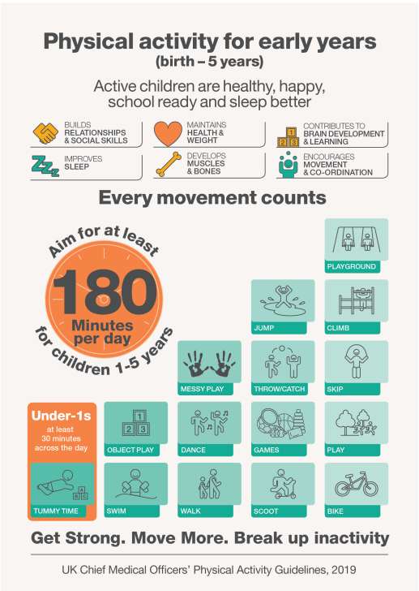
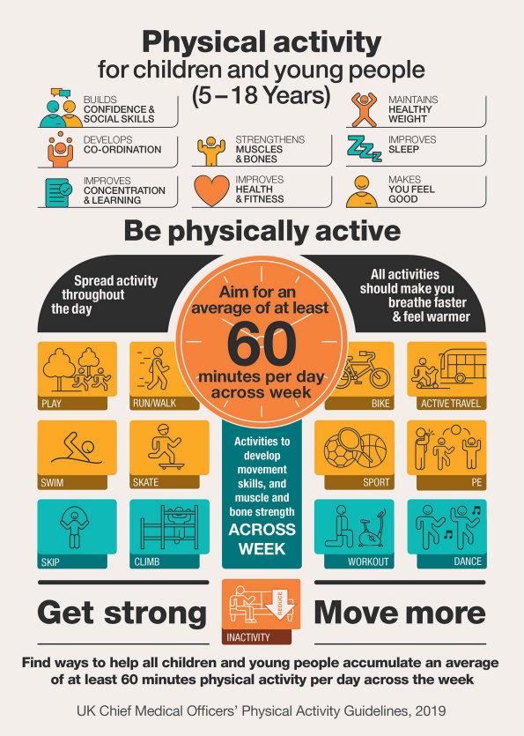
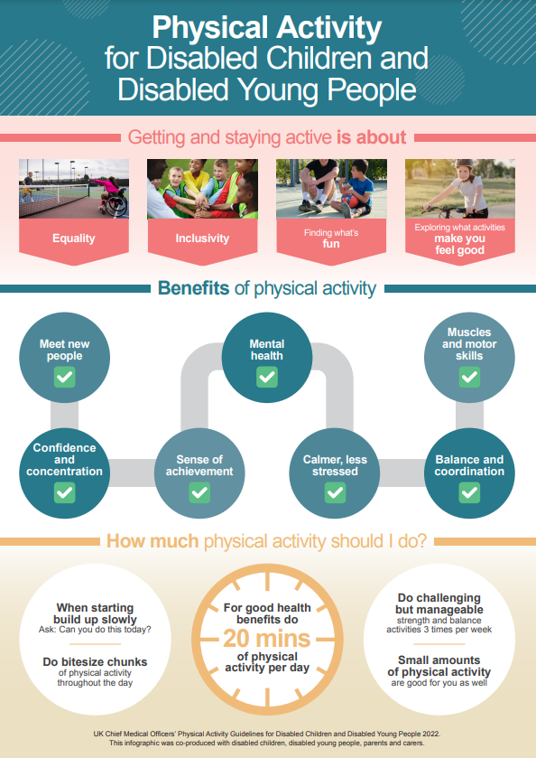
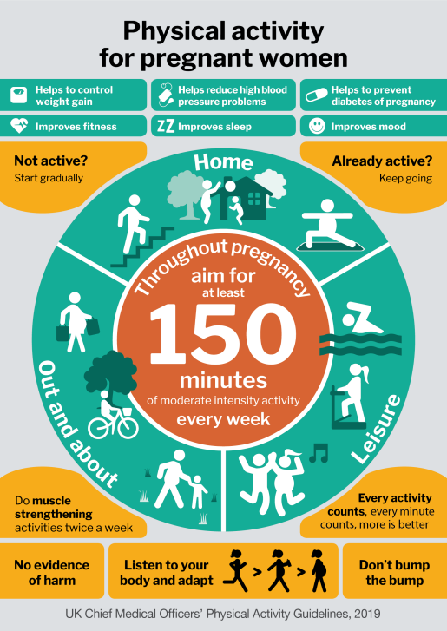
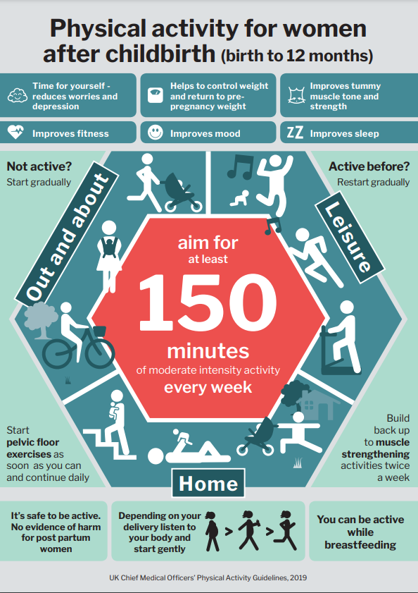
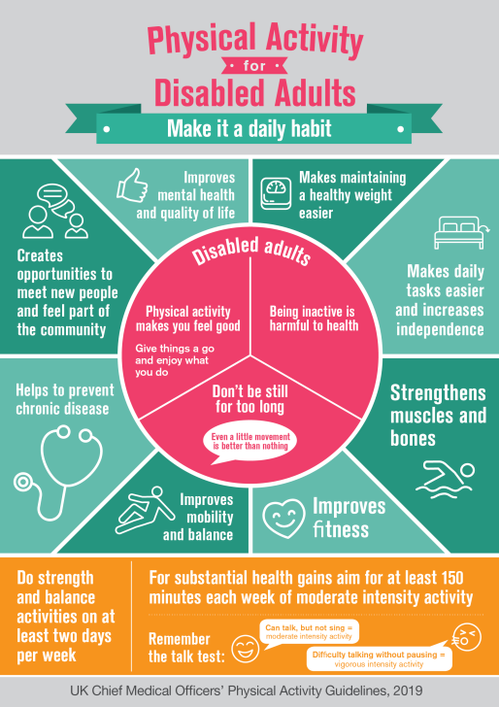
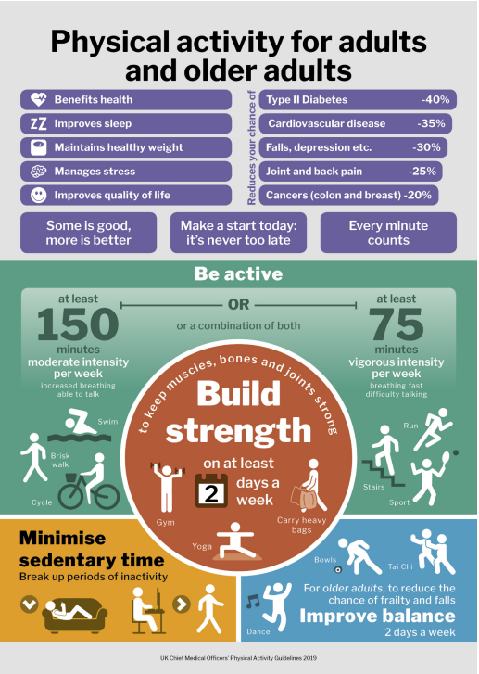
Chief Medical Officer physical activity guidelines
Summary of guidance for different population groups:
available from: Exercise and physical activity - GOV.UK (www.gov.uk)
The UK Chief Medical Officers’ Guidelines recommend each week for adults:
Be active every day
Do at least 150 minutes moderate intensity activity, 75 minutes’ vigorous activity, or a mixture of both (or adults aged 19-64 do very vigorous activity)
Do strengthening activities on two days
Reduce extended periods of sitting
Source: Physical activityguidelines: UK Chief Medical Officers' report - GOV.UK (www.gov.uk)

Slide 7
Examples of Activity
Examples of moderate activity:
Brisk walking, water aerobics, riding a bike, dancing, doubles tennis, pushing a lawn mower
Examples of vigorous activity:
Jogging or running, swimming fast, riding a bike fast or on hills, walking up the stairs, sports such as football, rugby and netball, aerobics, gymnastics, martial arts
Examples of muscle-strengthening exercises:
Carrying heavy shopping bags, yoga, Pilates, tai chi, lifting weights, working with resistance bands, push-ups and sit-ups, heavy gardening, wheeling a wheelchair, lifting and carrying children
Examples of very vigorous activity:
Lifting heavy weights, circuit training, sprinting up hills, interval training, spinning classes

Slide 8
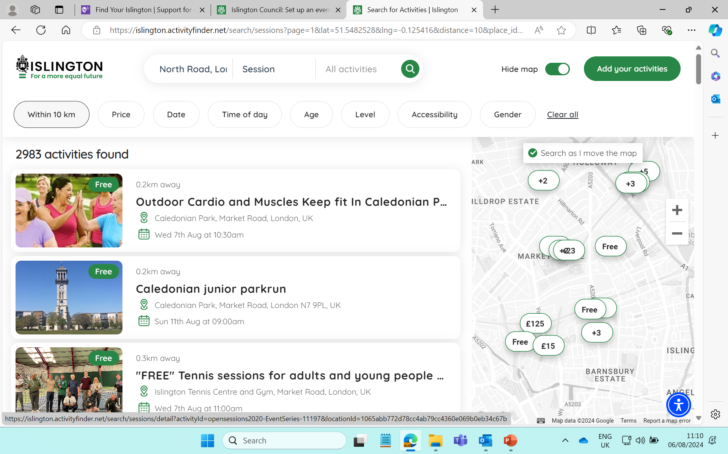
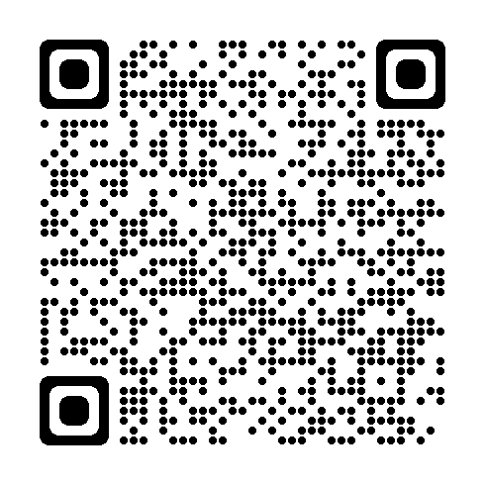
Physical Activity Offer in Islington
www.islington.gov.uk/active promotes:
A physical activity finder to search and book onto 2000+ activity sessions
Facilities including 7 leisure centres, 100+ parks & open spaces – 36 with sports facilities, 9 with outdoor gyms – 26 artificial and 3G pitches
Activities including 60 types of activity on offer, 60 sports clubs, 30 community centres & libraries offering physical activity, and free and low-cost activities
Activities suitable for specific groups, including young people, older people, people with a disability, women and girls, carers, LGBTQ+ community
A leaflet for each ward showing the local offer

